Slide 1

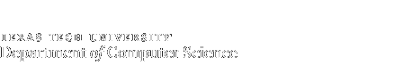

Advanced Operating Systems
Instructor: Tommy Dang, Ph.D.
Assistant Professor
Department of Computer Science
Texas Tech University

Slide 2
CPU utilization?
A computer has 1GB of memory, with OS taking up 512 MB and each user program taking up 256 MB
How many user programs (maximum) to be in memory at once?
With an 60% average IO wait. What is CPU utilization?

Slide 3
CPU utilization?
1 CPU.
I/O = 50%.
We have 2 processes, run concurrently.
U = 1- p^n = 1- 0.5^2 = 75%
Worst case: 67%
I/0
CPU time
I/0
CPU time
Best case: 100%
CPU time
I/0
I/0
CPU time

Slide 4
CPU utilization?
A computer has 1GB of memory, with OS taking up 512 MB and each user program taking up 256 MB
How many user programs (maximum) to be in memory at once?
With an 60% average IO wait. What is CPU utilization?
How to get the CPU utilization over 95%?

Slide 5
Outline
Virtual Memory
Paging
Page tables
Speeding up paging
Page tables for large memories

Slide 6
Virtual Memory
Driven by the need of running programs that are too large to fit in memory (or collectively with multiple programs)
Each process has its own address space, divided into pages
Pages mapped onto physical memory (not all)
When a process refers part of address space in physical memory, a hardware/software performs mapping on the fly
When not in memory, the OS load and re-execute instruction
Notes:
Designed by John Fotheringham in 1961

Slide 7
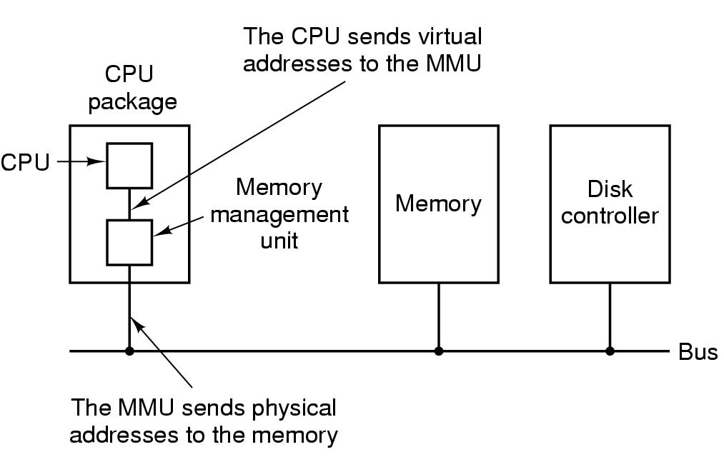
Paging (1)
Paging
Virtual address (CPU generated)
Virtual address space
MMU (Memory Management Unit)
Figure. The position and function of the MMU – shown as being a part of the CPU chip (it commonly is nowadays). Logically it could be a separate chip, was in years gone by.

Slide 8
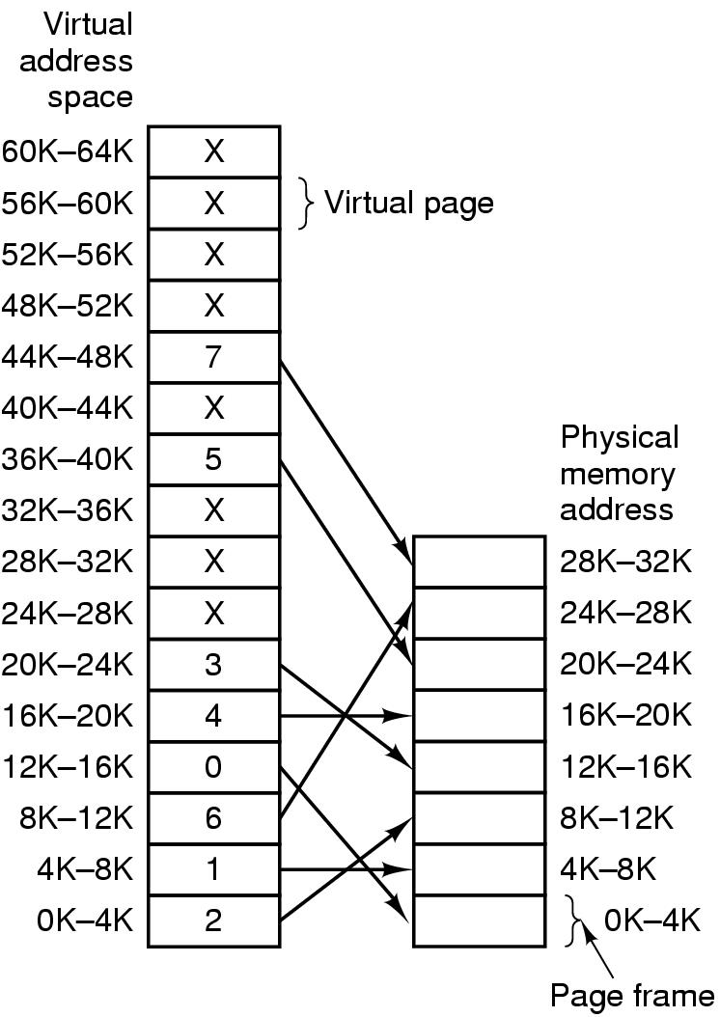
Paging (2)
Pages
Page frames
Page table (mapping function)
Page fault
Present/absent bit
Figure. Relation between virtual addresses and physical memory addresses given by page table.
Notes:
Where is the physical memory located? Where is the virtual memory located?
What is the size of the physical memory in the picture? = 32K

Slide 9
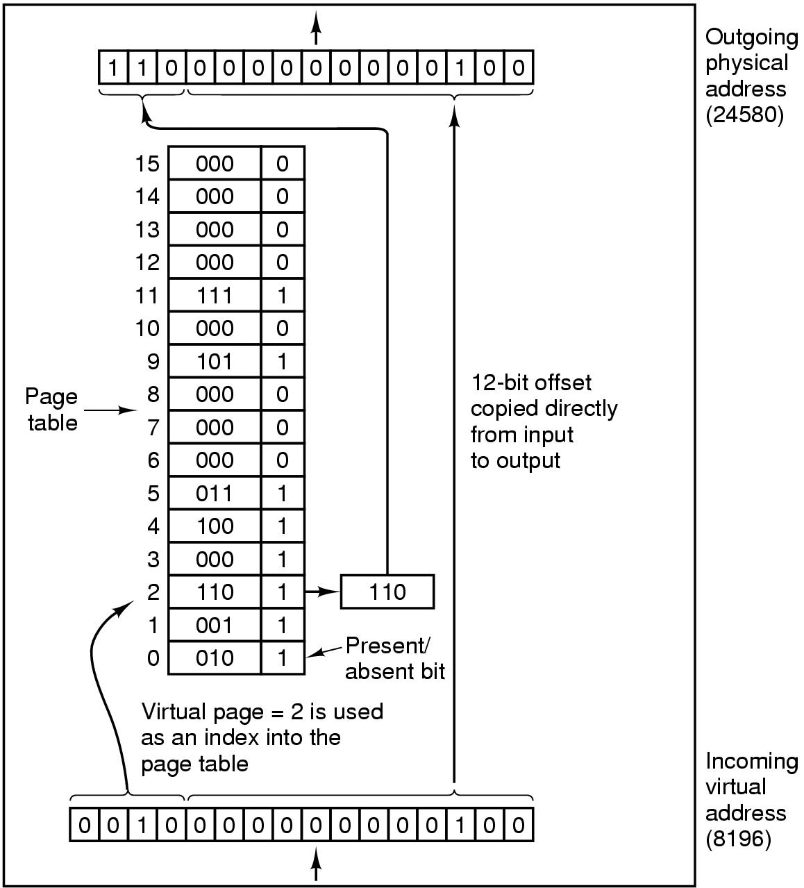
64KB of virtual address space (16 4KB pages) mapped onto 32KB of physical memory
Page number used as an index into the page table (mapping function)
What is the physical address of
Hex: #B004
1011 0000 0000 0010
0111 0000 0000 0010
Hex: #FFF0
Figure. The internal operation of the MMU with 16 4-KB pages.
Notes:
Answers: 1) #7004
2) Not yet loaded

Slide 10
Figure. Relation between virtual addresses and physical memory addresses given by page table.
Notes:
Where is the physical memory located? Where is the virtual memory located?
What is the size of the physical memory in the picture? = 32K

Slide 11
Quiz 1:
A computer has 32-bit virtual addresses and 4-KB pages. How many entries are needed in the page table if traditional (one-level) paging is used?

Slide 12
Quiz 1:
A computer has 32-bit virtual addresses and 4-KB pages. How many entries are needed in the page table if traditional (one-level) paging is used?
For a one-level page table, there are 2³² /2¹² or 1M (or 2²⁰) pages needed. Thus, the page table must have 1M (or 2²⁰) entries.

Slide 13
Paging implementation issues:
Virtual address to physical address mapping must be fast
Must be done every memory reference
If virtual address space is large, the page table will be large
With 4KB page size, 32-bit address -> how many pages,
With 4KB page size, 64-bit address -> how many pages,
Notes:
With 4KB page size, 32-bit address has 1M (2²⁰) pages,
64-bit address has 2⁵² (4K trillion) pages

Slide 14
Quiz 2:
A computer provides each process with 64KB of address space divided into pages of 4KB. A particular program has a text size of 32 KB, a data size of 17 KB, and a stack size of 13KB bytes.
Will this program fit in the address space?
If the page size were 1KB, would it fit? Each page must contain either text, data, or stack, not a mixture of two or three of them.
Please explain your answers.

Slide 15
Quiz 2:
A computer provides each process with 64KB of address space divided into pages of 4KB. A particular program has a text size of 32 KB, a data size of 17 KB, and a stack size of 13KB bytes. 4KB text
Will this program fit in the address space?
If the page size were 1KB, would it fit?
The text is eight pages, the data are five pages, and the stack is four pages. The program does not fit because it needs 17 pages. Internal frag = 6KB
With a 1KB page, the situation is different. Here the text is 32 pages, the data are 17 pages, and the stack is 13 pages, for a total of 62 1KB pages, which fits. Internal frag = 0KB
With the small page size it is OK, but not with the large one.

Slide 16
Quiz 3:
A computer provides each process with 65,536 bytes of address space divided into pages of 4096 bytes. A particular program has a text size of 32,768 bytes, a data size of 16,386 bytes, and a stack size of 15,870 bytes. Will this program fit in the address space
If the page size were 512 bytes, would it fit?
Each page must contain either text, data, or stack, not a mixture of two or three of them.

Slide 17
The text is eight pages, the data are five pages, and the stack is four pages. The program does not fit because it needs 17 4096-byte pages.
With a 512- byte page, the situation is different. Here the text is 64 pages, the data are 33 pages, and the stack is 31 pages, for a total of 128 512-byte pages, which fits. With the small page size it is OK, but not with the large one.

Slide 18
Quiz 4:
A computer has 32-bit virtual addresses and 128-KB pages.
How many entries are needed in the page table if traditional (one-level) paging is used?
If the physical memory is half size of virtual memory, many page frames are there in the physical memory?

Slide 19
Quiz 4:
A computer has 32-bit virtual addresses and 128-KB pages.
How many entries are needed in the page table if traditional (one-level) paging is used?
For a one-level page table, there are 2³² /2¹⁷ or 2¹⁵ pages needed. Thus, the page table must have 2¹⁵ entries.
If the physical memory is half size of virtual memory, many page frames are there in the physical memory?
2¹⁴ entries.

Slide 20
Quiz 5:
A computer has 30-bit virtual addresses and 8-KB pages.
How many entries are needed in the page table if traditional (one-level) paging is used?
If the physical memory is half size of virtual memory, many page frames are there in the physical memory?

Slide 21
Quiz 5:
A computer has 30-bit virtual addresses and 8-KB pages.
For a one-level page table, there are 2³⁰ /2¹³ or 2¹⁷ pages needed. Thus, the page table must have 2¹⁷ entries.
2¹⁶ entries.

Slide 22
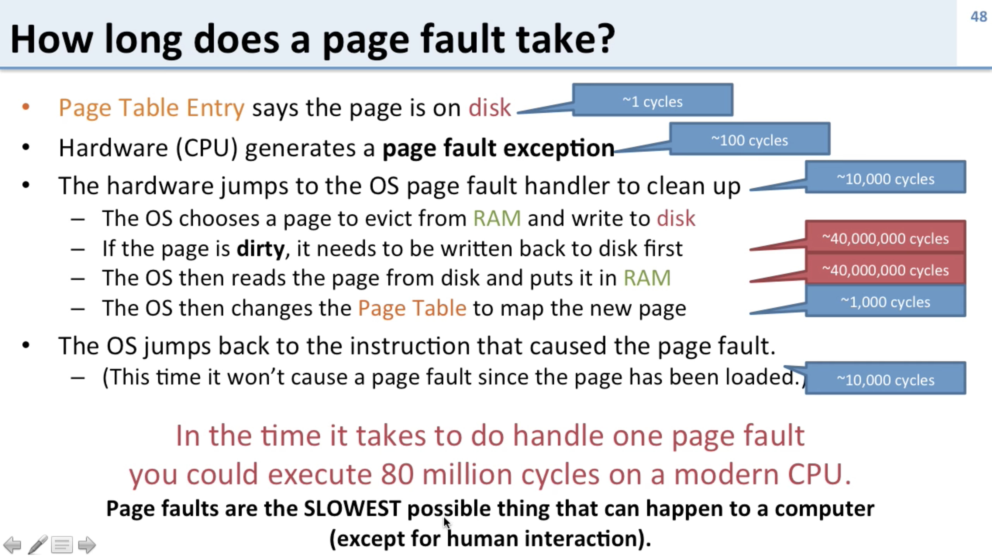
https://www.youtube.com/watch?v=bShqyf-hDfg

Slide 23
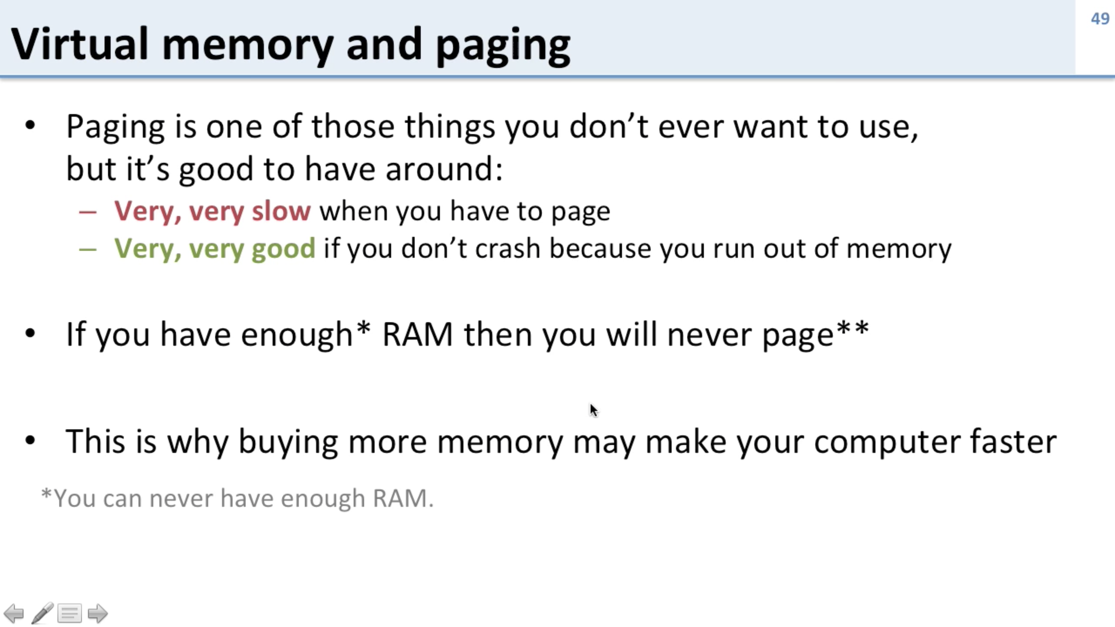
https://www.youtube.com/watch?v=bShqyf-hDfg

Slide 24
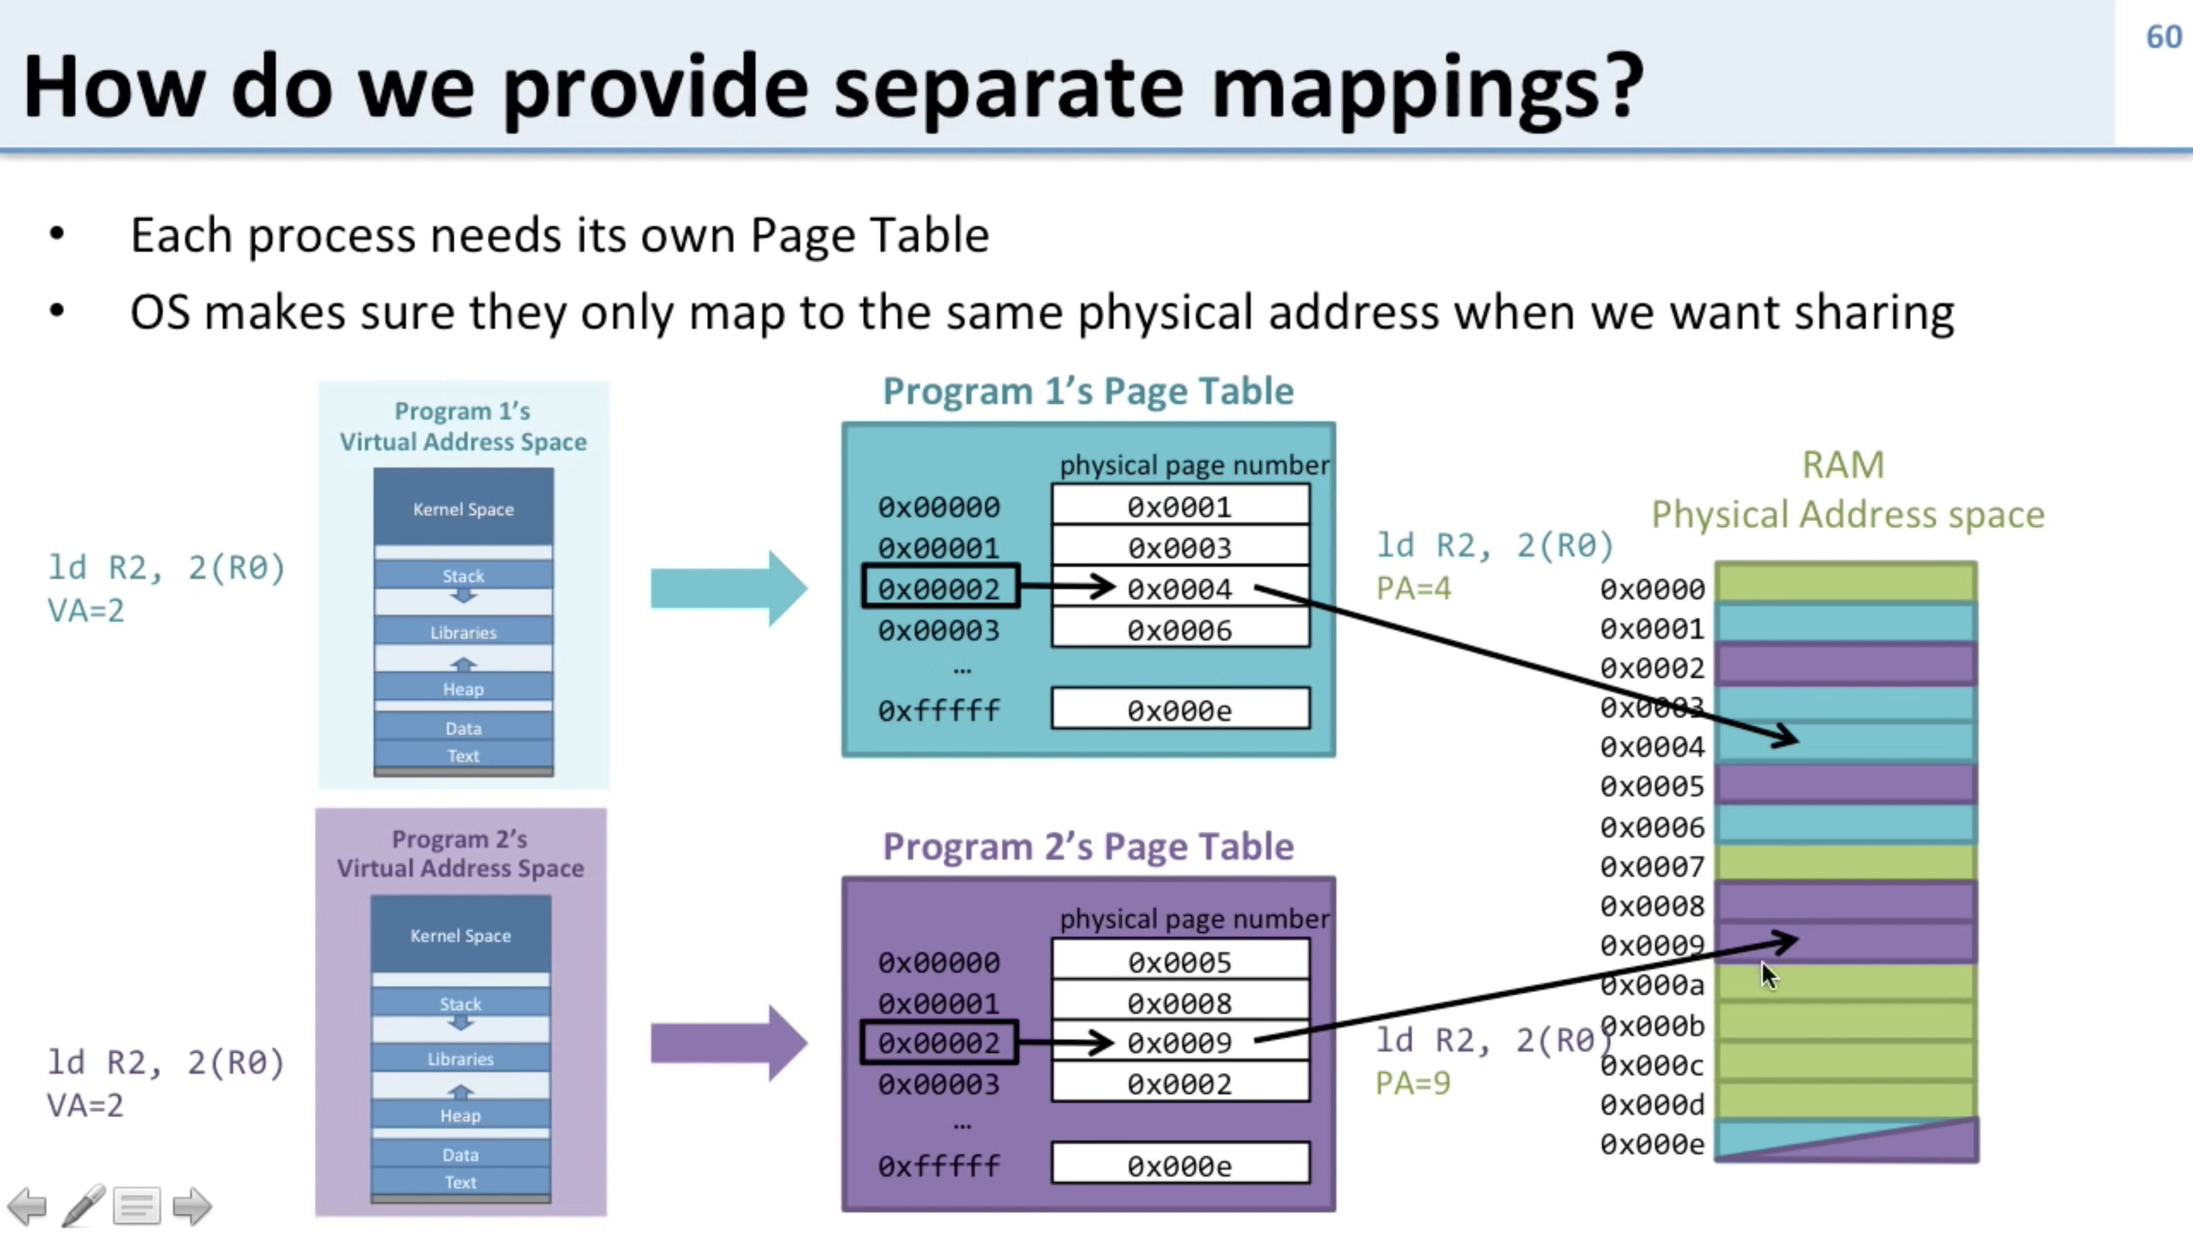
https://www.youtube.com/watch?v=uyrSn3qbZ8U

Slide 25
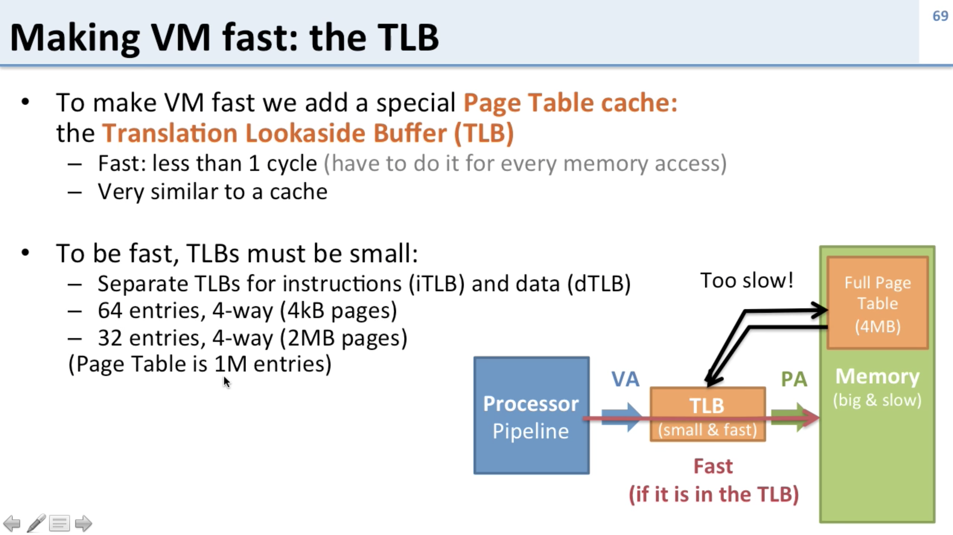
https://www.youtube.com/watch?v=uyrSn3qbZ8U

Slide 26
Outline
Questions?
Virtual Memory
Paging, Page tables
Speeding up paging
Page tables for large memories
Page Replacement Algorithms
Optimal algorithm
NRU, FIFO, Second-chance algorithms
Clock, LRU, Aging algorithms
Working set and WSClock algorithms
Summary

Slide 27
Page Replacement Algorithms
When a page fault occurs, if page frames full, OS needs to choose a page to evict to make room
Similar to cache line replacement
Different in how fast they require
If the evicted page is dirty, it needs to be written back to disk
If clean, no rewrite needed
Naïve random algorithm possible, but we can do a better job!
Notes:
Page Replacement occurs in other areas of computer design: web browsers, catch in CPU.

Slide 28
Optimal Page Replacement Algorithm (OPT)
Best possible algorithm is to pick the page who has the furthest distance to be accessed again
E.g. if pages A, B, C, D in memory, E is referenced and needs to replace a page, with future accesses A, C, D, B, C, …Which one to be picked?
B
Impossible to implement though, need a magic fortune teller!

Slide 29
Not Recently Used (NRU)
Associate two bits for each page
R: reference bit, set when referenced (read/written)
M: modified bit, set when written
OS classifies into 4 classes and NRU picks a random page from the lowest-numbered nonempty class (higher priority to stay with reuse)
Class 0: not referenced, not modified ->
Class 1: not referenced, modified. -> page 3 -> page 13
Class 2: referenced, not modified
Class 3: referenced, modified
Notes:
Referenced is reset by OS every clock cycle (interrupt): Class 1 can achieved by resetting Referenced on class 3 on clock cycle.

Slide 30
First-In First-Out (FIFO)
FIFO picks the oldest page as the victim page to be replaced
Low-overhead, little book-keeping, easy to implement (FIFO queue)
Issue: ?
heavily-used early arrival page can be replaced

Slide 31
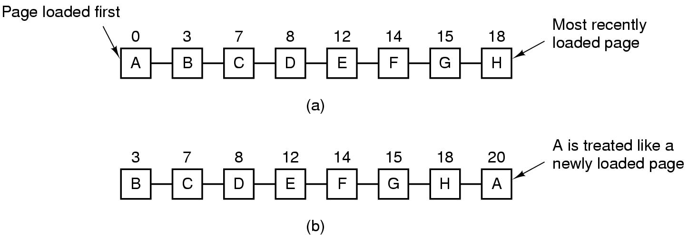
Second Chance Algorithm
Follows FIFO, but check R bit; if 0, replaced; if 1, clear R bit and put into the end of the queue
Figure. Operation of second chance. (a) Pages sorted in FIFO order. (b) Page list if a page fault occurs at time 20 and A has its R bit set. The numbers above the pages are their load times.

Slide 32
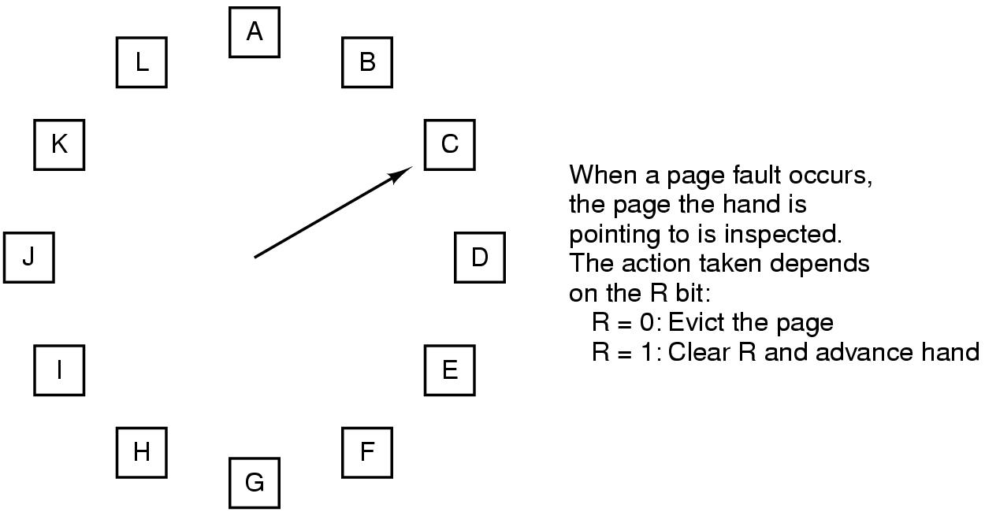
The Clock Page Replacement Algorithm
Figure 3-16. The clock page replacement algorithm.
Notes:
Similar to FIFO with second chance. But this move the pointer instead of move the page to the end of the list

Slide 33
Least Recently Used (LRU) Algorithm (1)
LRU picks the page that has not been used for the longest time
Good approximation of OPT
Not cheap to implement though
Needs a linked list and needs to update this linked list on every memory reference
Hardware implementations
With a counter incrementing after each instruction (“timer”); each page table entry stores a counter value, entry with lowest counter picked
With a matrix of n x n bits, for n page frames

Slide 34
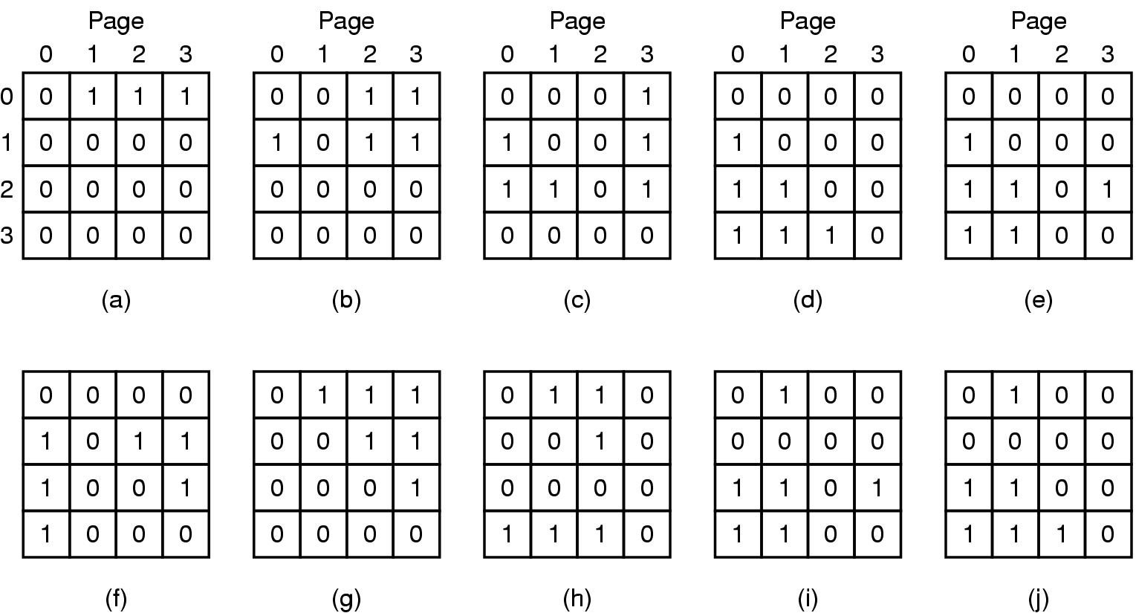
Least Recently Used (LRU) Algorithm (2)
When page frame k referenced, row k sets to 1, col k sets to 0
Row with lowest binary value picked
LRU using a matrix when pages are referenced in the order 0, 1, 2, 3, 2, 1, 0, 3, 2, 3.

Slide 35
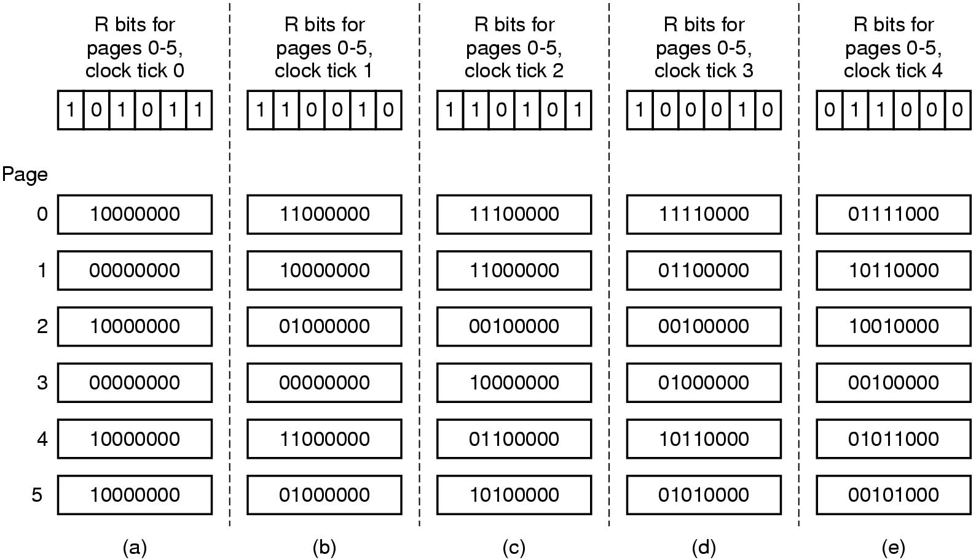
Simulating LRU in Software – Aging Algorithm
Software counter associated with each page
Counter shifted right 1 bit, and R bit added in to the leftmost, at each clock interrupt
Not exact LRU, e.g. pages 3 and 5 after not referenced a while
Figure. The aging algorithm simulates LRU in software. Shown are six pages for five clock ticks. The five clock ticks are represented by (a) to (e).
Notes:
We are able distinguish within 8 clock cycle but not more than 8 clock cycle

Slide 36
Working Set Page Replacement (1)
The set of pages a process currently using called working set
Principle of locality
Demand paging: pages are loaded only on demand
Thrashing: if a process has frequent page faults e.g. every few instructions
Prepaging (working set model)
Working set page replacement algorithm
Find a page not in the working set and evict it
Notes:
If the entire working set of the process is in the memory, then no page fault for that execution phase.
Principle of locality: process references only a small fraction of its pages during each execution phase.
Thrashing is because available memory is too small
Prepaging is the opposite of demand paging

Slide 37
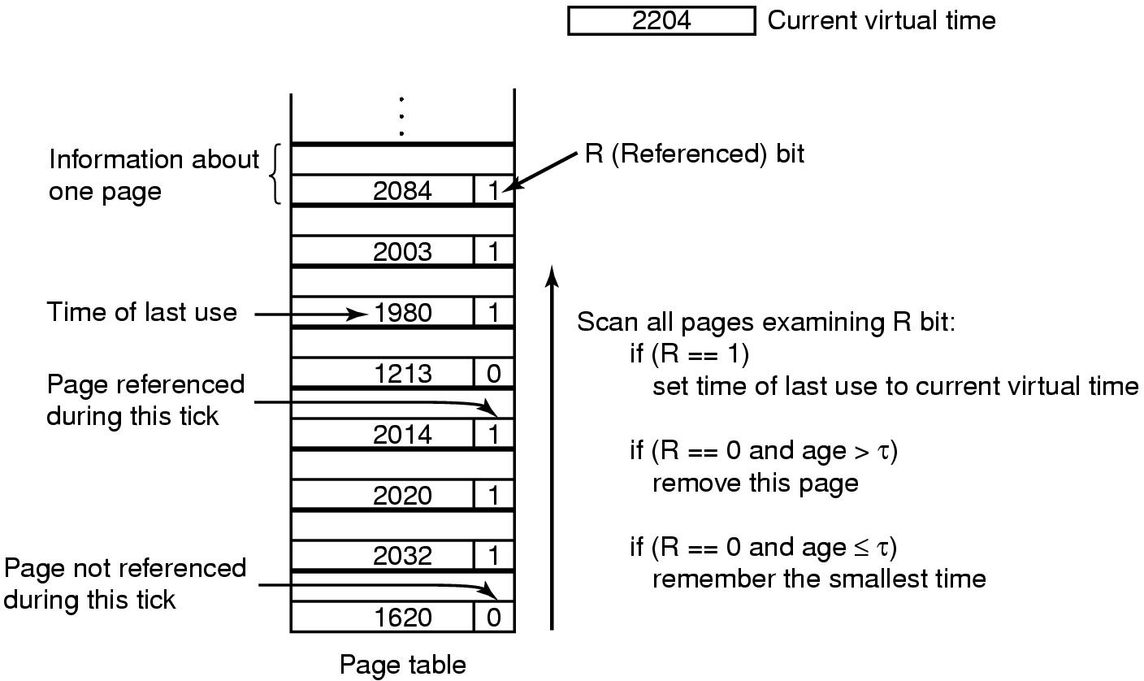
Working Set Page Replacement (2)
Current virtual time: amount of CPU time a process has used since started
On clock interrupt, set all R = 0
τ: a threshold for defining working set
Figure. The working set algorithm.
Notes:
Not sure why R==1, we have to set the last use = current virtual time?
Maybe because we want to increase its priority in the next page replacement (now his R=0 due to the clock tick). Similar idea of the second chance
In the worst case, all R=1 -> select randomly

Slide 38
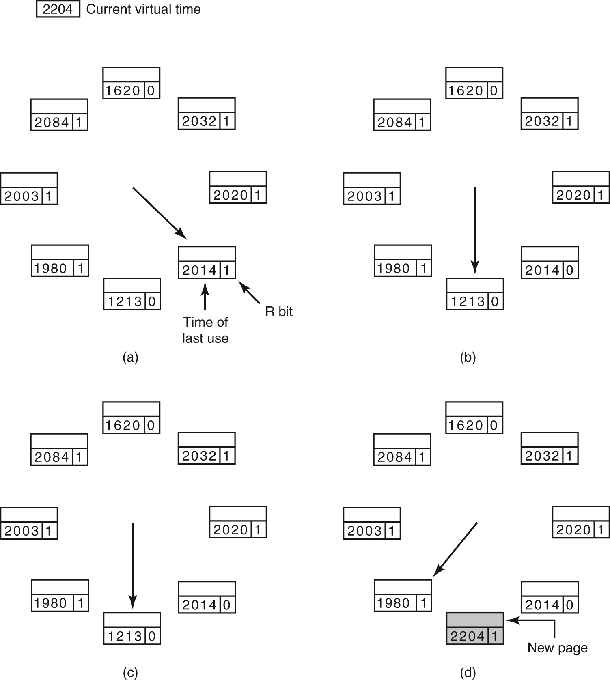
The WSClock Page Replacement Algorithm (1)
Figure. Operation of the WSClock algorithm. (a) and (b) give an example of what happens when R = 1.

Slide 39
The WSClock Page Replacement Algorithm (2)
Figure. Operation of the WSClock algorithm.
(c) and (d) give an example of R = 0.

Slide 40
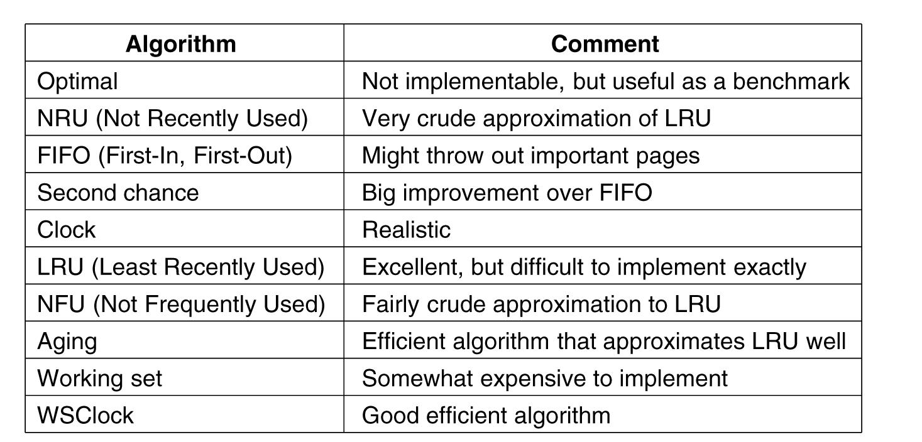
Summary of Page Replacement Algorithms
Figure. Page replacement algorithms discussed in the text.

